Slide 1
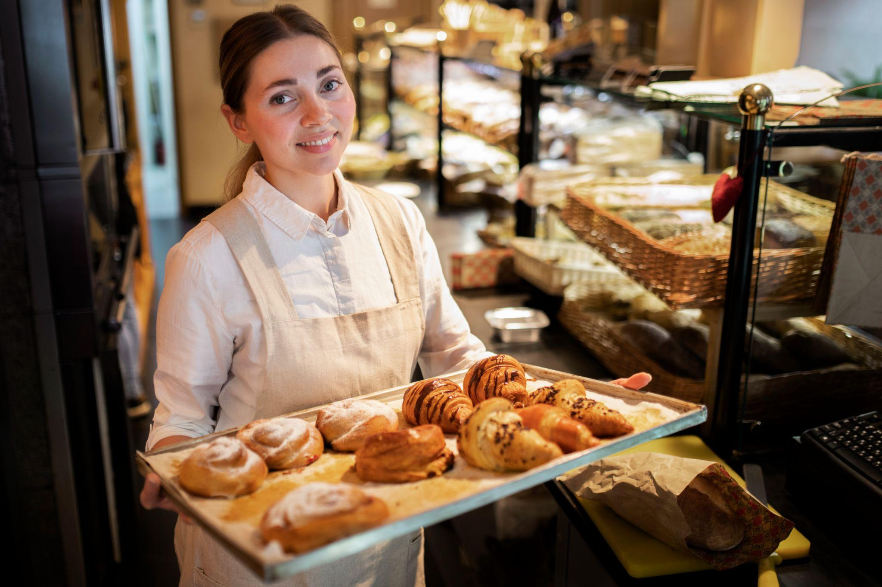
Sweet Byte Delights

Slide 2
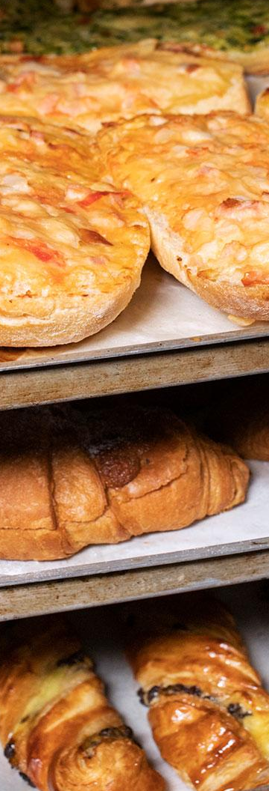
Our team
Khush Gadhwal
Garima Parmar
Rohit Tailor
Bachelor Of Technology
Computer Science Department
Project :- Sweet Byte Delights
Roll No – 20ETCCS062
Enrollment No – 20E1TCCSM30P062
Roll No – 20ETCCS040
Enrollment No – 20E1TCCSF40P040
Roll No – 20ETCCS097
Enrollment No – 20E1TCCSM30P097
Himanshi Suhalka
Roll No – 20ETCCS051
Enrollment No – 20E1TCCSF30P051

Slide 3
Table of contents
01.
02.
03.
Problem Statement
Objective & Scope
Methodology
04.
05.
06.
Application & Future Scope
Project Timeline
References / Bibliography

Slide 4
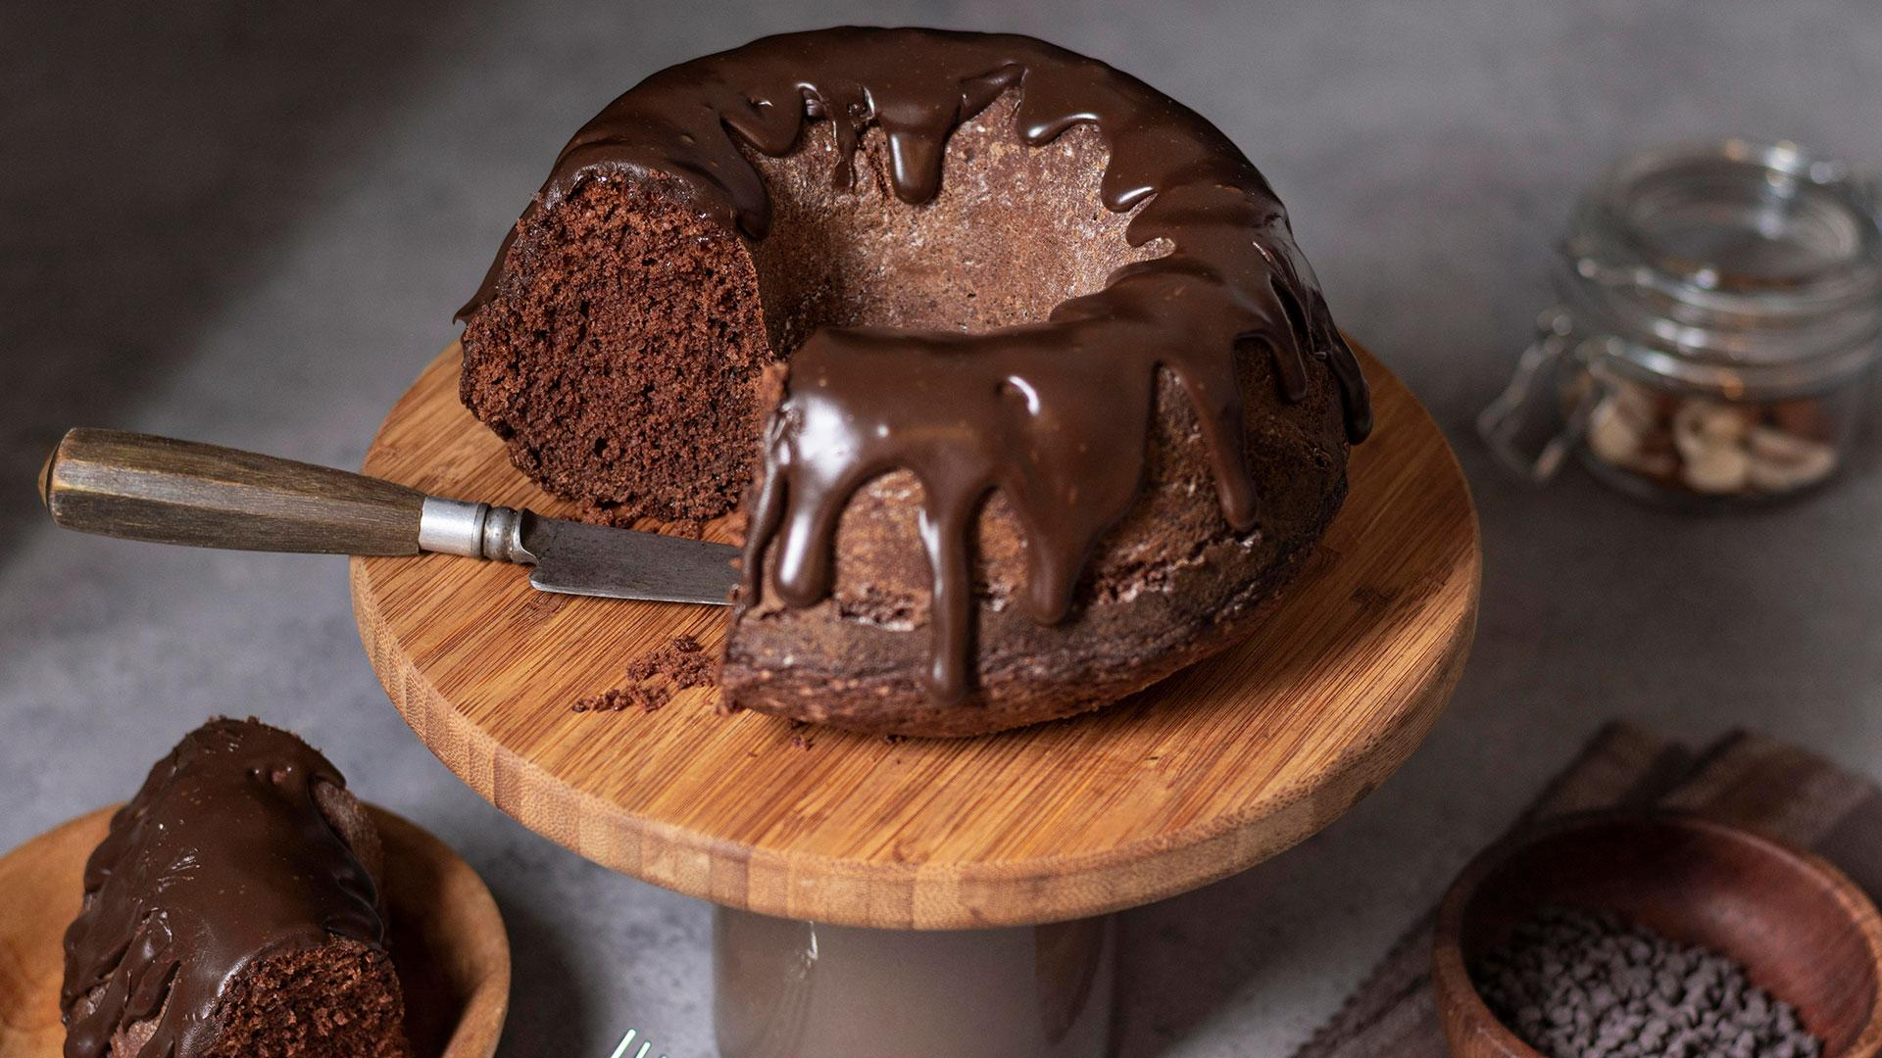
Problem Statement
Traditional bakeries face limitations in reaching customers beyond physical stores. This project aims to develop an Online Bakery Management System, enabling bakery owners to easily view received orders, while customers can create accounts, browse products, place orders. The system seeks to enhance more customer engagement and streamline bakery operations.

Slide 5
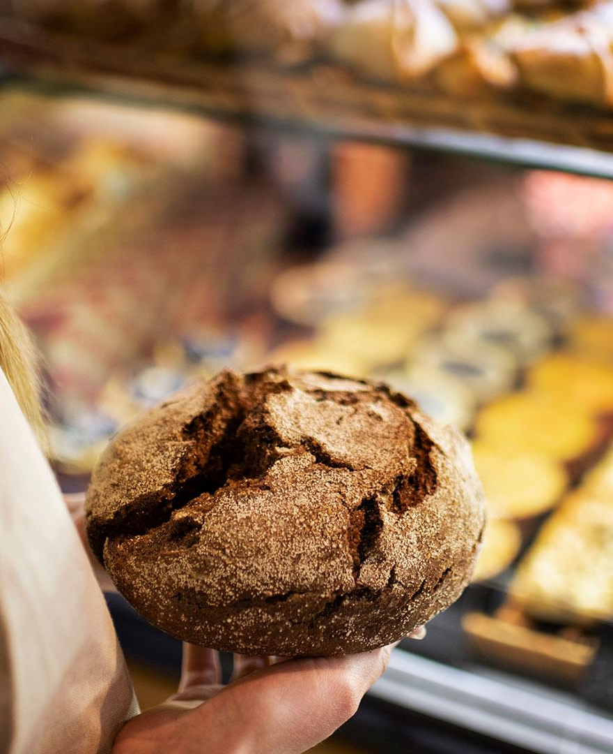
Objective & Scope
Objective :- The objective of this project is to create an Online Bakery Management System to bridge the gap between traditional bakeries and customers. The system aims to enhance customer interaction, streamline bakery operations, and provide a seamless online experience for both administrators and customers.
Scope :- The scope of an online bakery involves offering a wide range of baked goods through a user-friendly platform, ensuring efficient delivery, maintaining quality, prioritizing customer satisfaction, implementing sustainable practices, and planning for growth and scalability.

Slide 6

Methodology
Creating a food delivery system that involves various functionalities to ensure a seamless experience for both customer and businesses. Here are essential features and functionalities you may want to consider :
User Registration and Authentication
Browse and Search
Menu Display
Order Placement
Payment
User Reviews
User Profile

Slide 7
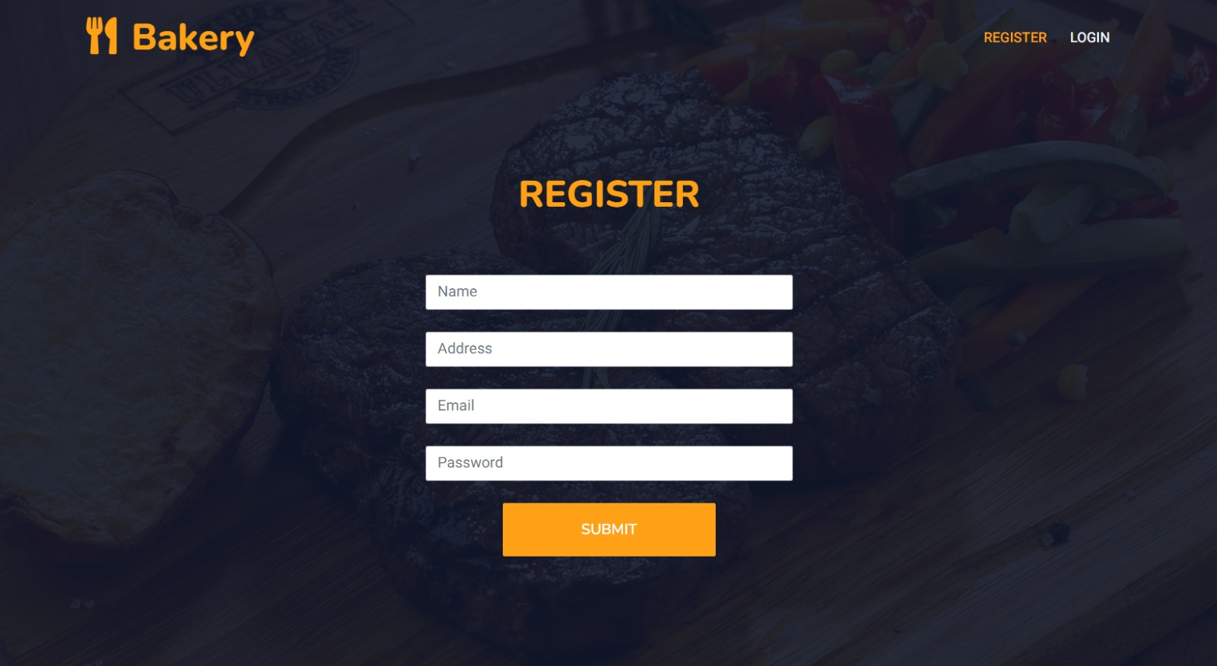
Registration Page :-

Slide 8
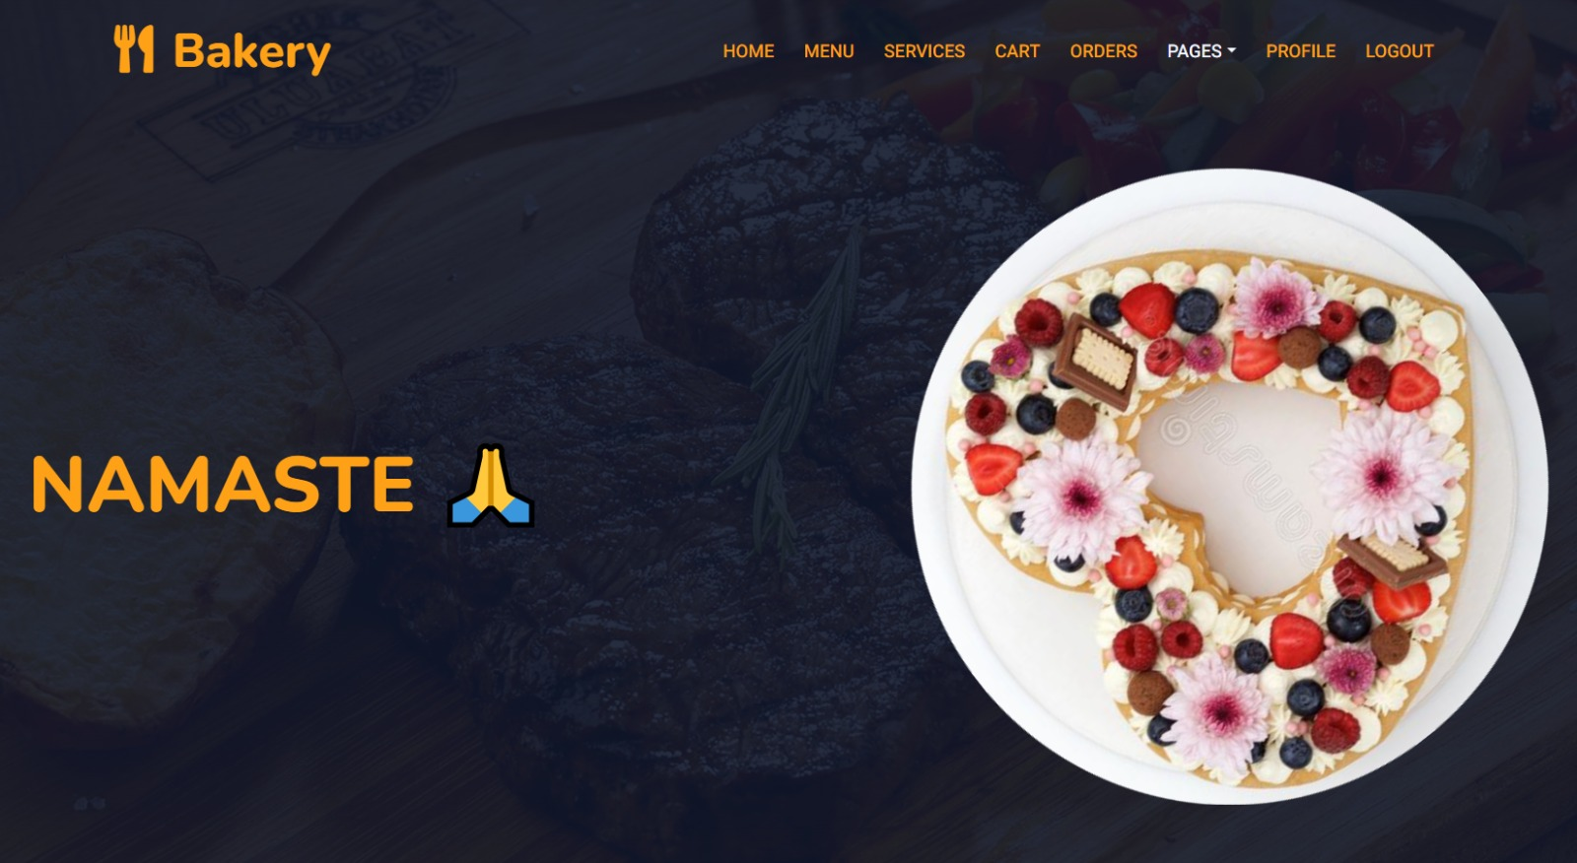
Home Page :-

Slide 9
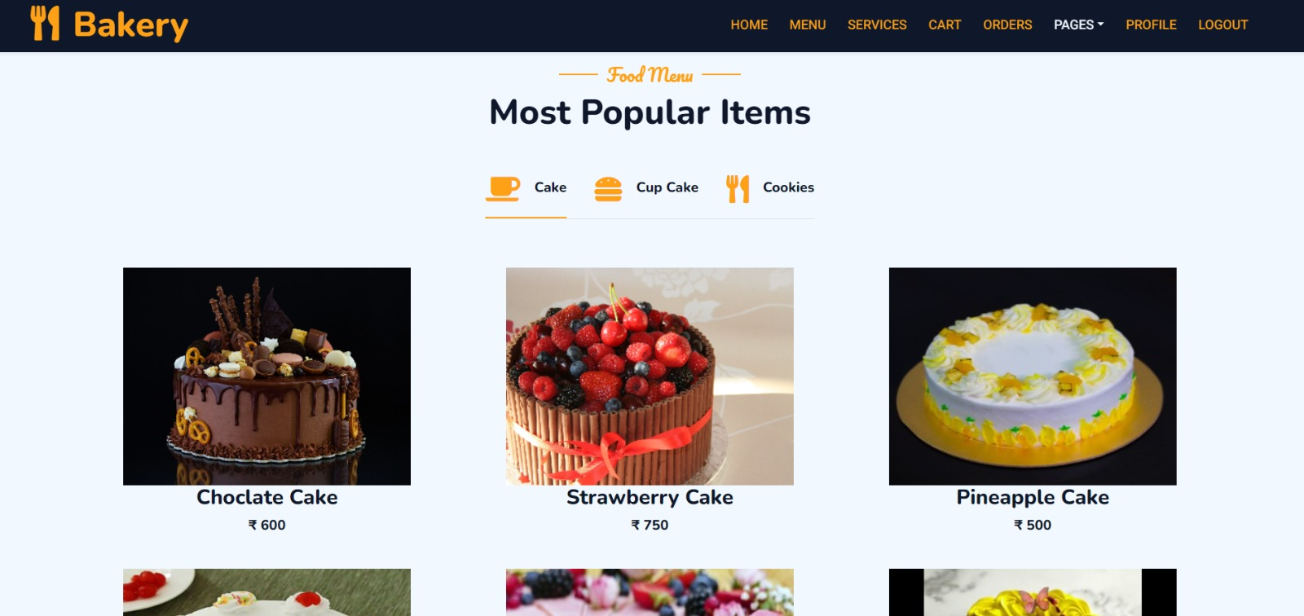
Menu Page :-

Slide 10
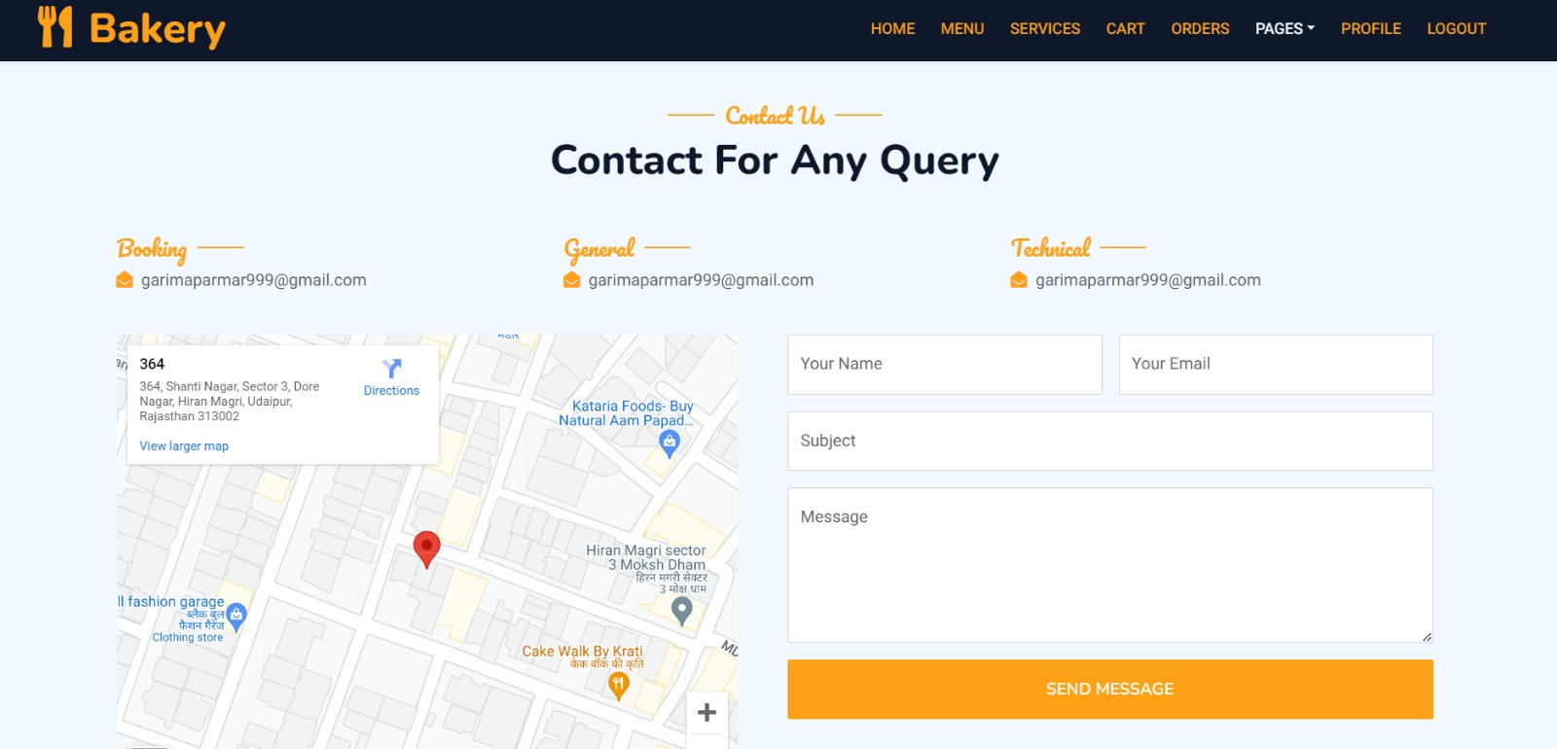
Contact Page :-

Slide 11
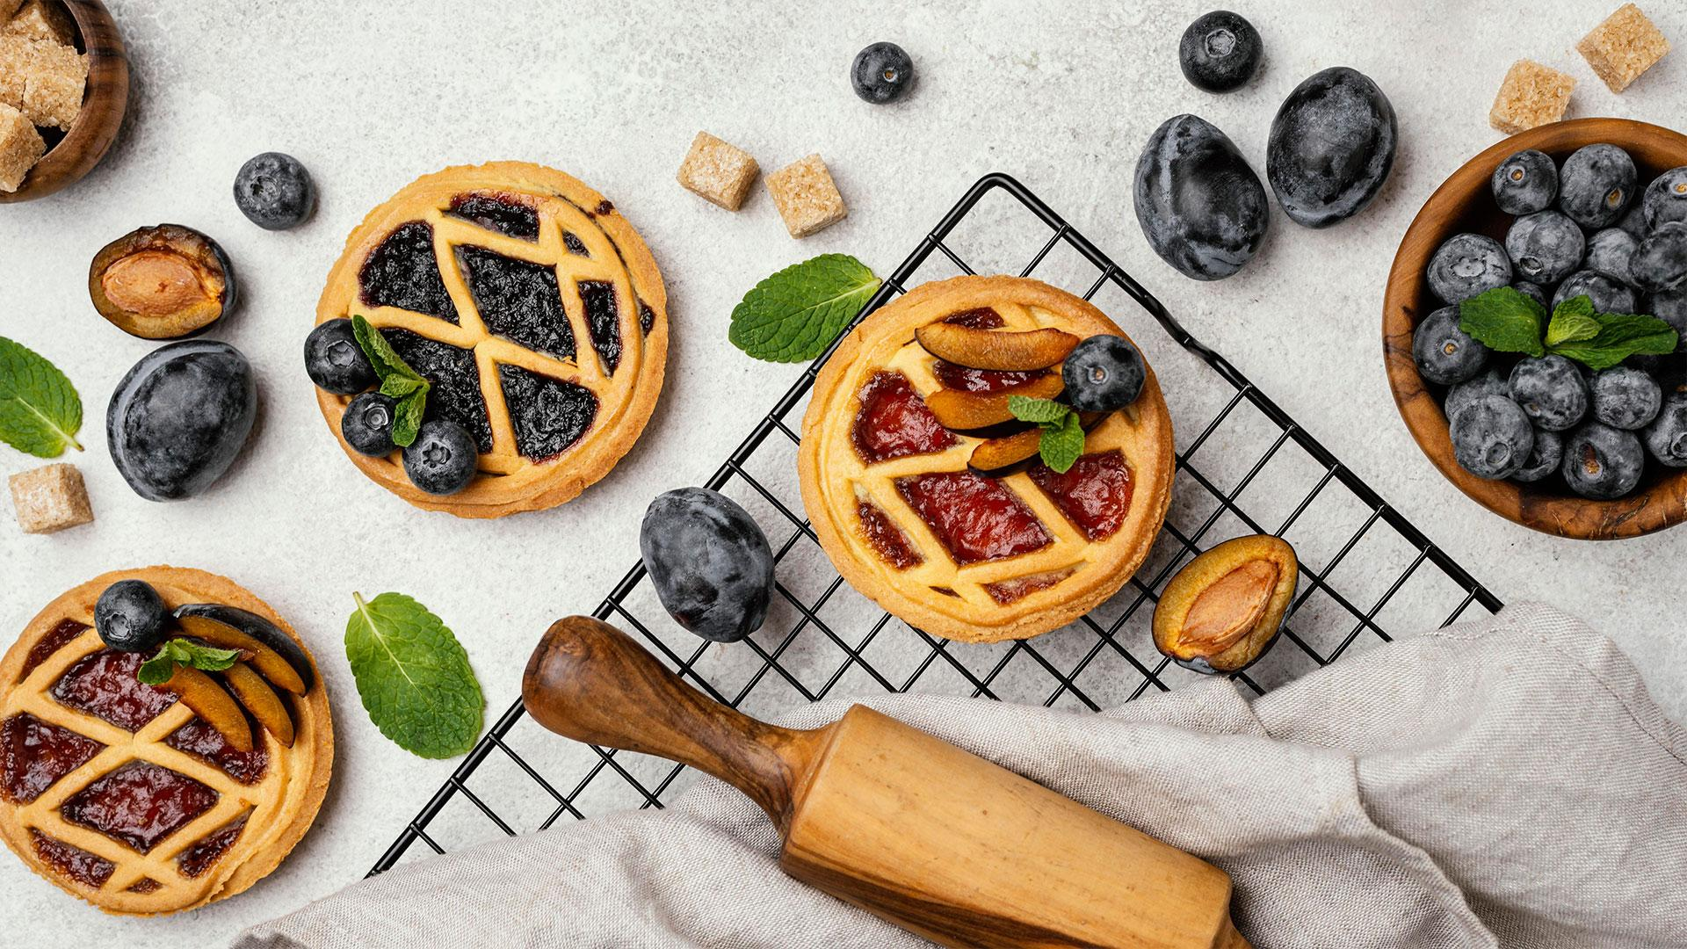
Application & Future Scope
Our bakery website simplifies the process of ordering and paying for baked goods, enhancing customer convenience.
Future advancements may involve integrating AI for personalized recommendations and leveraging data analytics for business insights. Expansion opportunities include implementing loyalty programs, enhancing customer engagement through social media integration, and optimizing delivery logistics for efficiency through SMS and WhatsApp messages.

Slide 12
Project Timeline
 | Week 1 | Week 2 | Week 3 | Week 4 | Week 5 | Week 6 | Week 7
Phase 1 | Planning Phase
Phase 2 |  |  | Website Development
Phase 3 |  |  |  |  |  | Testing Deployment

Slide 13
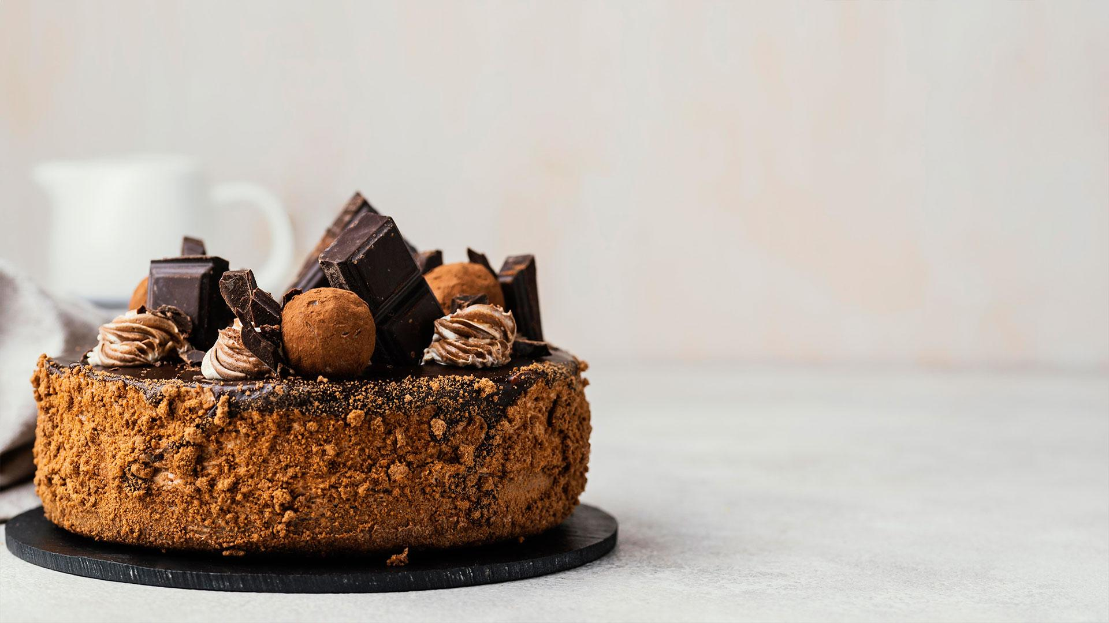
References / Bibliography
The Bread Baker's Guild of America - https://www.bbga.org/
King Arthur Baking- https://www.kingarthurbaking.com/
Back Door Donuts - https://www.backdoordonuts.com/

Slide 14
Thanks !
Do you have any questions?

